Slide 1
LEAVE REQUEST MANAGEMENT SYSTEM

Slide 2
PROBLEM STATEMENT
The existing leave request management system provides essential modules such as employee self‑service, manager dashboards, absence management, approvals, reporting, and viewing. However, the current user interface is outdated and not optimized for ease of use, resulting in a less engaging experience for employees and managers. Navigating dashboards, submitting requests, and tracking approvals can feel cumbersome, which reduces efficiency and adoption. A modern, intuitive UI is needed to improve accessibility, streamline interactions, and enhance the overall user experience while keeping the system’s core functionality intact.

Slide 3
SOLUTION
Retain Existing Modules
Employee Self Service Dashboard, Manager Dashboard, Manage Absence, Approve Section, Report Section, Absence Analytics and View Section remain unchanged.
Modern User Interface
Redesigned UI with intuitive navigation, clean layouts, and improved accessibility.
Improved Manager Tools
Streamlined approval workflows, clearer team availability calendars, and conflict alerts for faster decisions.
Enhanced Employee Experience
Easier leave application, balance tracking, and request monitoring through a self‑service dashboard.
Focus and usability
Simplified interactions, reduced clicks, and visually engaging dashboards to boost adoption.
Outcome
Greater efficiency, transparency, and satisfaction without altering the system’s core functionality.

Slide 4
FEATURES FOR EMPLOYEE
Apply / Schedule Leave – Submit requests for different types of leave with ease
Absence History – View past leave records and approvals
Leave Balances – Check available leave balance in real time
Cancel Leave – Withdraw or cancel previously applied leave requests
Compensatory Off Request – Apply for compensatory off based on extra work hours/days
Compensatory Off Status – Track approval status of compensatory off requests

Slide 5
FEATURES FOR MANAGER
Approve Section:-
Approve Leave Requests – Review and approve/reject employee leave applications
Approve Leave Cancellation – Handle cancellation requests submitted by employees
Approve Compensatory Off – Validate and approve compensatory off requests
Report Section:-
Schedule Leave – Generate reports on scheduled leaves for planning
Cancel Leave – Track and report cancelled leave requests
View Section:-
Leave Balance – Access employee leave balances for decision‑making
Absence History – Review detailed absence records of employees
Absence Analytics
Analyze leave trends, team availability, and absence patterns for better workforce planning

Slide 6
FLOW DIAGRAM

Slide 7
SEQUENCE DIAGRAM

Slide 8
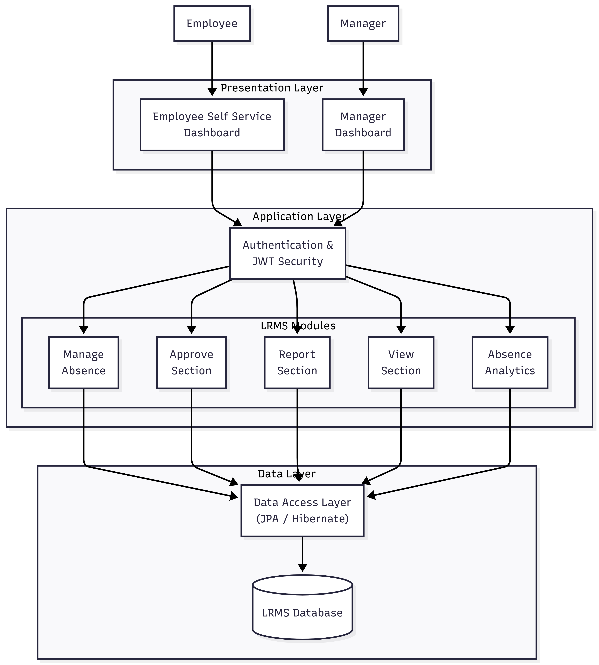
ARCHITECTURE DIAGRAM

Slide 9
TECHNOLOGY STACK
Frontend: Angular – Builds responsive, role-based dashboards for employees and managers
Backend: Spring Boot – Handles business logic and exposes REST APIs for LRMS modules
Database: MySQL – Stores user, leave, approval, and historical data securely
Security: JWT Authentication, Role-Based Authorization, Secure APIs, and Data Protection

Slide 10
Thank You !!

